Slide 1





High Impedance Faults
Risks
Undetected HIFs can spark fires, disrupt power with outages, and degrade equipment over time. These risks threaten safety and reliability, making effective detection critical to prevent costly and hazardous consequences.
High Impedance Faults (HIF) occur when current flows through high-resistance paths like trees or insulators, producing low currents that evade traditional relays
dsd
Overview
Approach
Goals
Importance
Our goal is precise, adaptable HIF detection using a Simulink dataset and CNN training. We aim to create a scalable solution for safer, more reliable electrical networks.
Detecting HIFs prevents fires and failures, enhancing safety and grid stability. This project strengthens electrical systems, ensuring reliable power delivery and supporting modern infrastructure needs.
We use Wavelet Packet Analysis to extract signal features and CNN to classify faults accurately. This blend of signal processing and deep learning tackles HIF detection effectively.

Slide 2




Our Approach
01
02
We created a Simulink model based on IEEE papers to simulate HIFs, low-current faults through high-resistance paths. It includes a testing system to replicate realistic fault behavior accurately.
The Simulink model generated a 4 lakh sample DATA POINTS of normal and HIF currents over time. This captures key variations for robust signal and fault analysis.
03
04
We perform FFT on signals .It provides frequency insights into normal and HIF currents. This guides the selection of wavelet decomposition levels.
Using PyWavelet (level 3, db4 wavelet), we decomposed the dataset to analyze non-stationary HIF signals. It isolates time-frequency details for precise fault detection.

Slide 3
Our Approach
05
06
Sixteen parameters (e.g., mean, kurtosis) were computed per wavelet chunk to profile signal behavior. This quantifies differences between normal and fault conditions.
The computed statistical parameters were then used for feature ranking, prioritizing those with the maximum distance between their distributions under normal and fault conditions.
07
08
We then build a 1D CNN model using selected features and refined it through hyperparameter tuning. This process enhances HIF pattern recognition for dependable and accurate detection.
The trained CNN model's performance was evaluated using a dedicated test set, and several key metrics were calculated to assess its effectiveness.

Slide 4
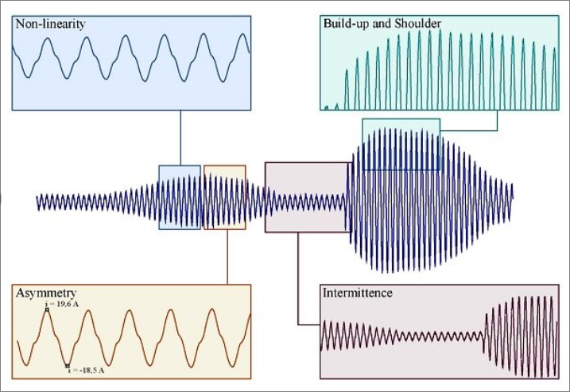
Characteristics of HIF
Low magnitude fault current.
Non-linear voltage-current relation.
Random/chaotic current waveform
Asymmetrical current cycles.
Significant harmonic content.
Intermittent/fluctuating flow.

Slide 5
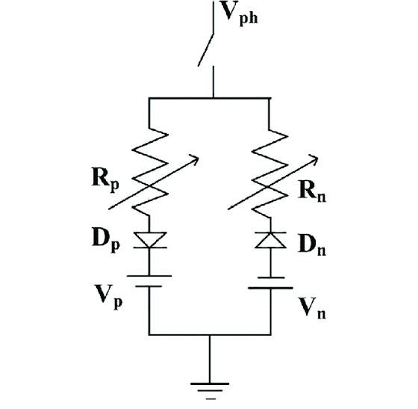
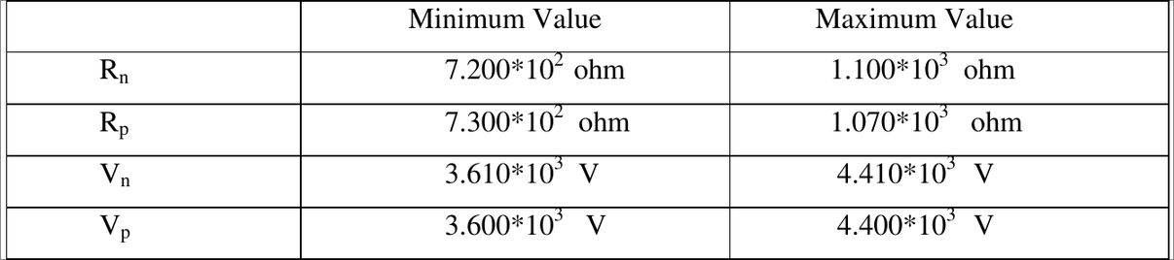
HIF MODEL
Based on Emanuel Arc Model[1].
Resistance and voltage are varied every 0.1ms[2].
The range of variation of the resistances is restricted such that the fault current always lies below 10% of the full load current[2].
The model uses variable resistors to represent the effective impedance of the fault, which can vary significantly in real-world HIF scenarios.
DC controlled sources are used to model the voltage drop across the arc.
Diodes introduce asymmetry to the fault current by allowing current flow in only one direction,mimicking the uneven conduction during an arcing fault.

Slide 6
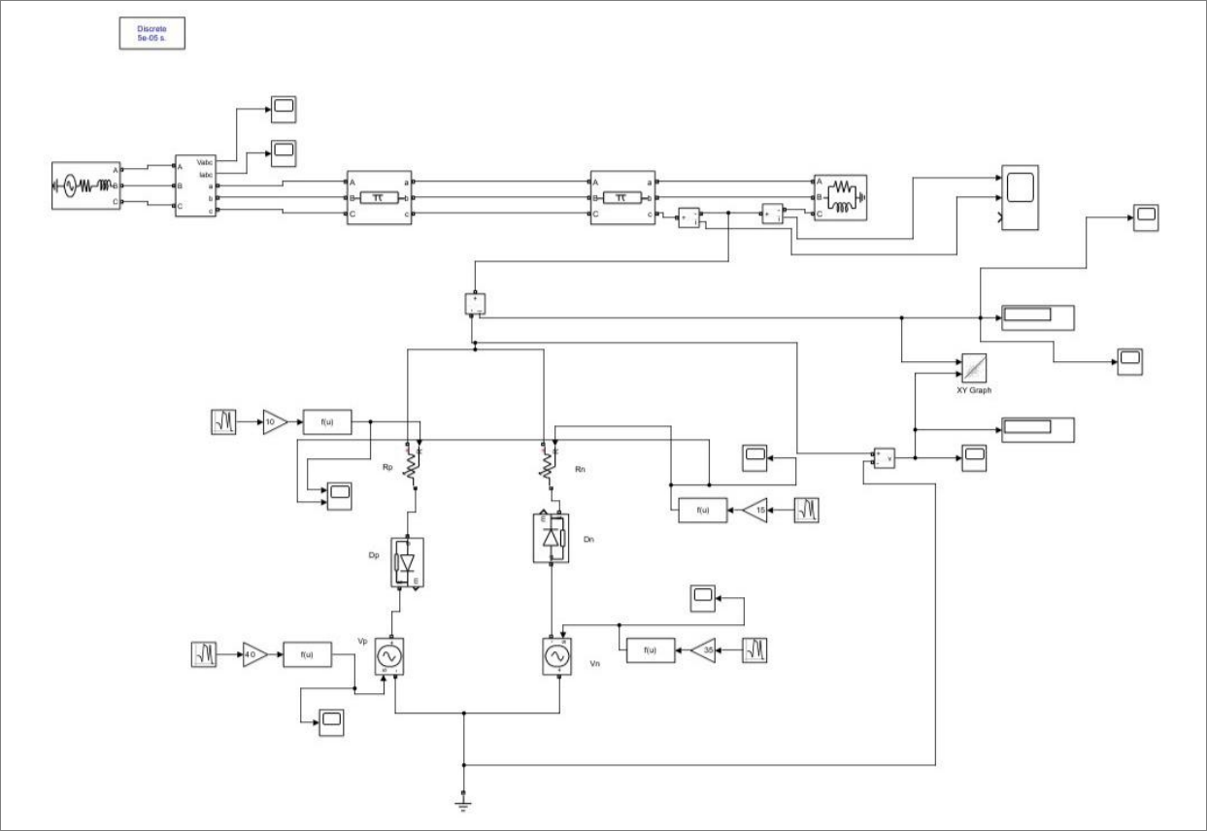
SIMULINK MODEL
Testing System
HIF Model

Slide 7
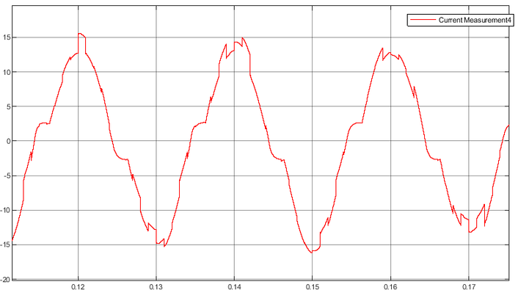
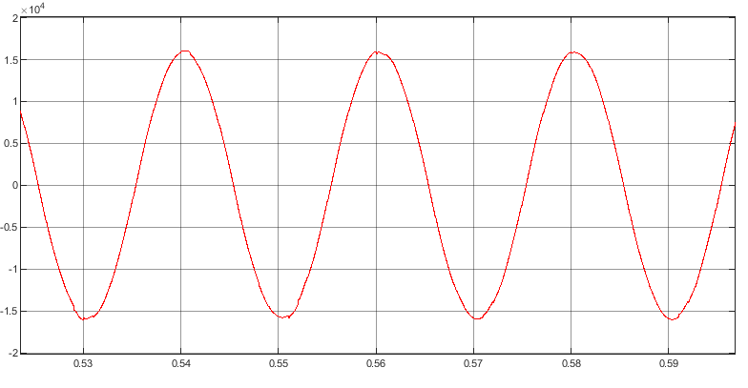
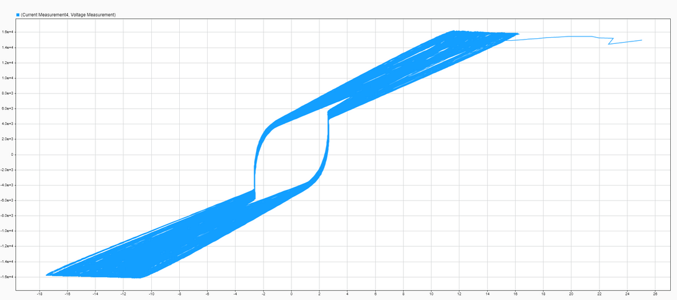
CHARACTERISTICS
HIF Current
HIF Arc Voltage
VI Characteristics

Slide 8
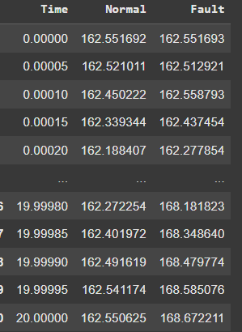
Generating Training Set

Slide 9
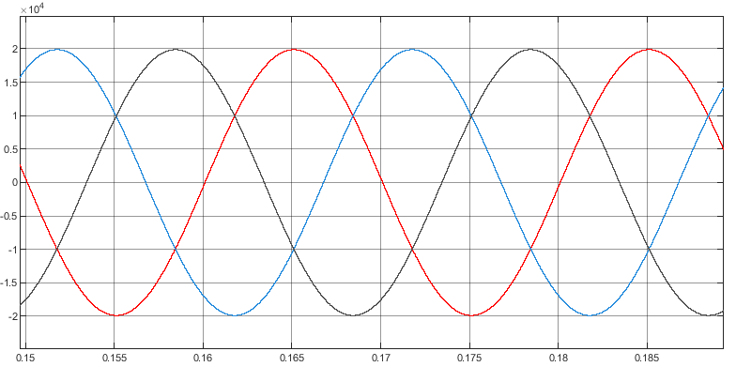
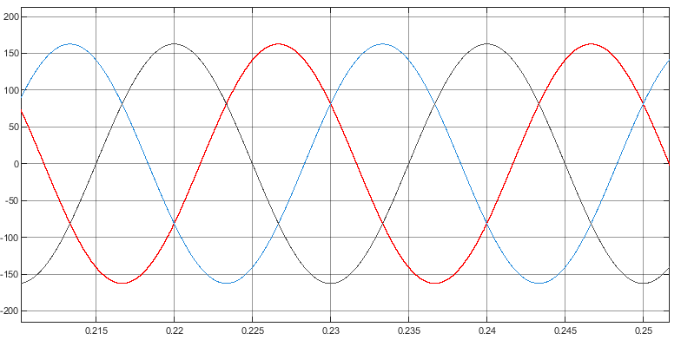
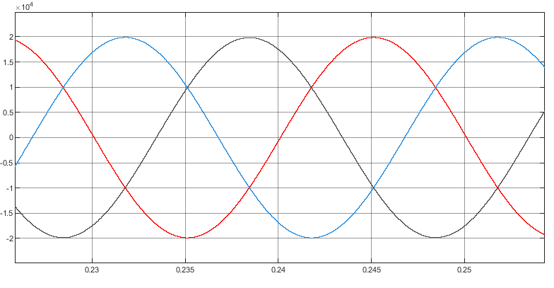
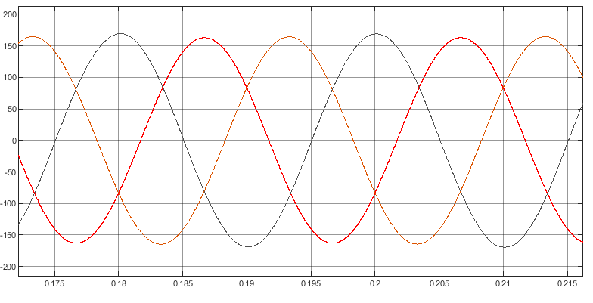
Difficulty in Detecting HIF
Normal Voltage
Normal Current
Fault Voltage
Fault Current

Slide 10

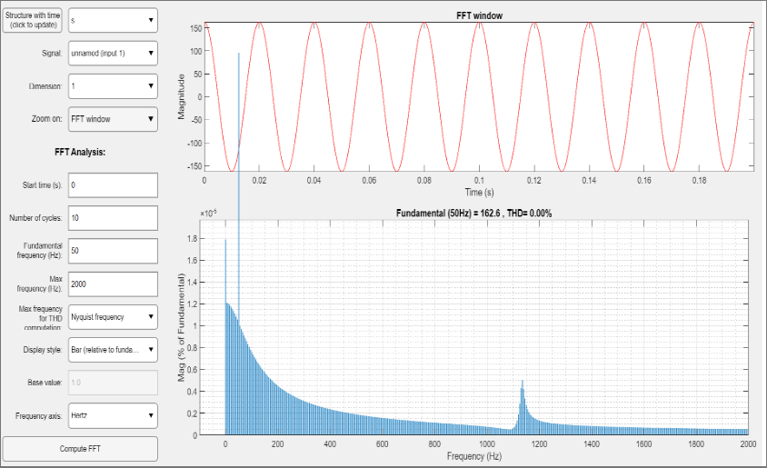

FFT Analysis for normal current
FFT analysis of the normal current dataset provided a baseline frequency spectrum.
Results indicate that harmonics in the normal current spectrum are negligible, confirming stable operating conditions without significant distortions.

Slide 11
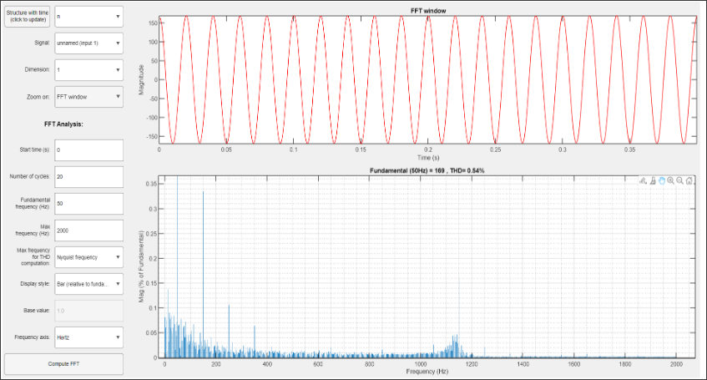
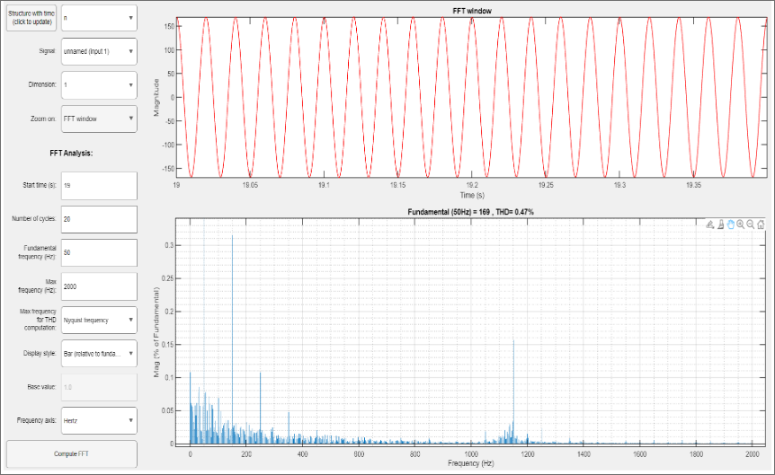
FFT Analysis for Fault current
FFT analysis of the fault current dataset at different time intervals revealed consistent spectral variations.
In each analyzed case, specific harmonic orders, including the 3rd, 5th, and 23rd harmonics, along with underharmonics, were observed to dominate the signal.
Based on the inferences from the fast Fourier transform results we could conclude that a three level decomposition for the wavelet packet analysis will convey majority of the information present in the data set.

Slide 12
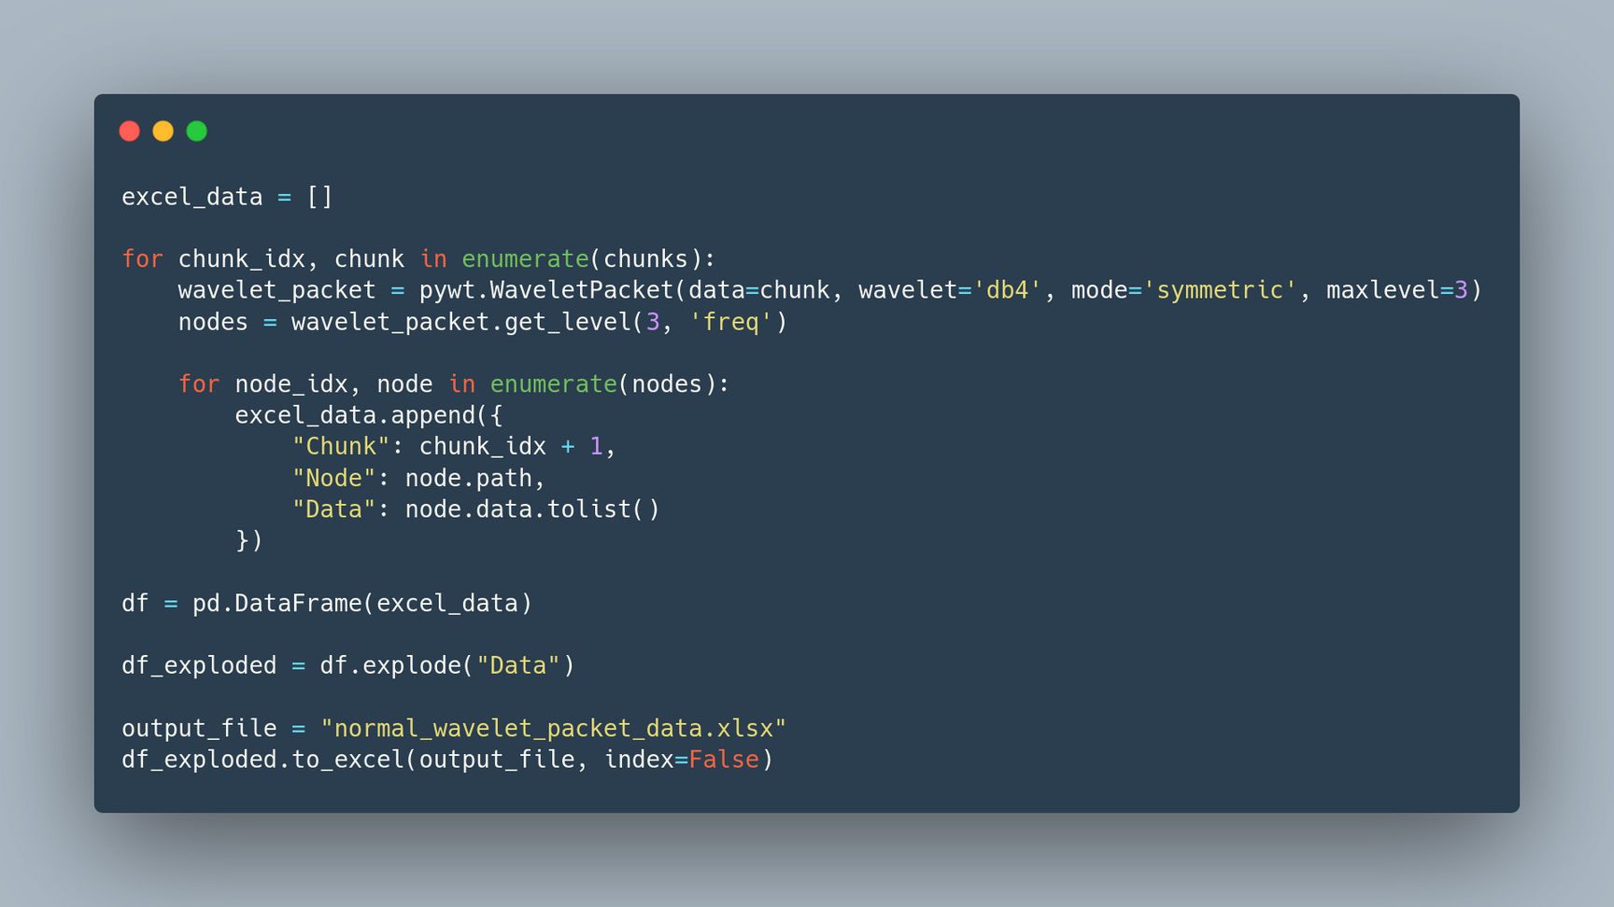
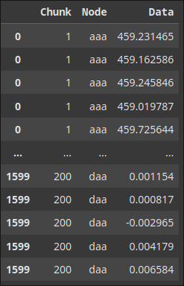
Creating Wavelet Packets
For each chunk, we creates a WaveletPacket object using the db4 mother wavelet[3], decomposing the data up to level 3 with symmetric boundary handling.
Each WaveletPacket object (containing the decomposition tree) is appended to normal_wavelet_packets for further analysis or reconstruction.

Slide 13
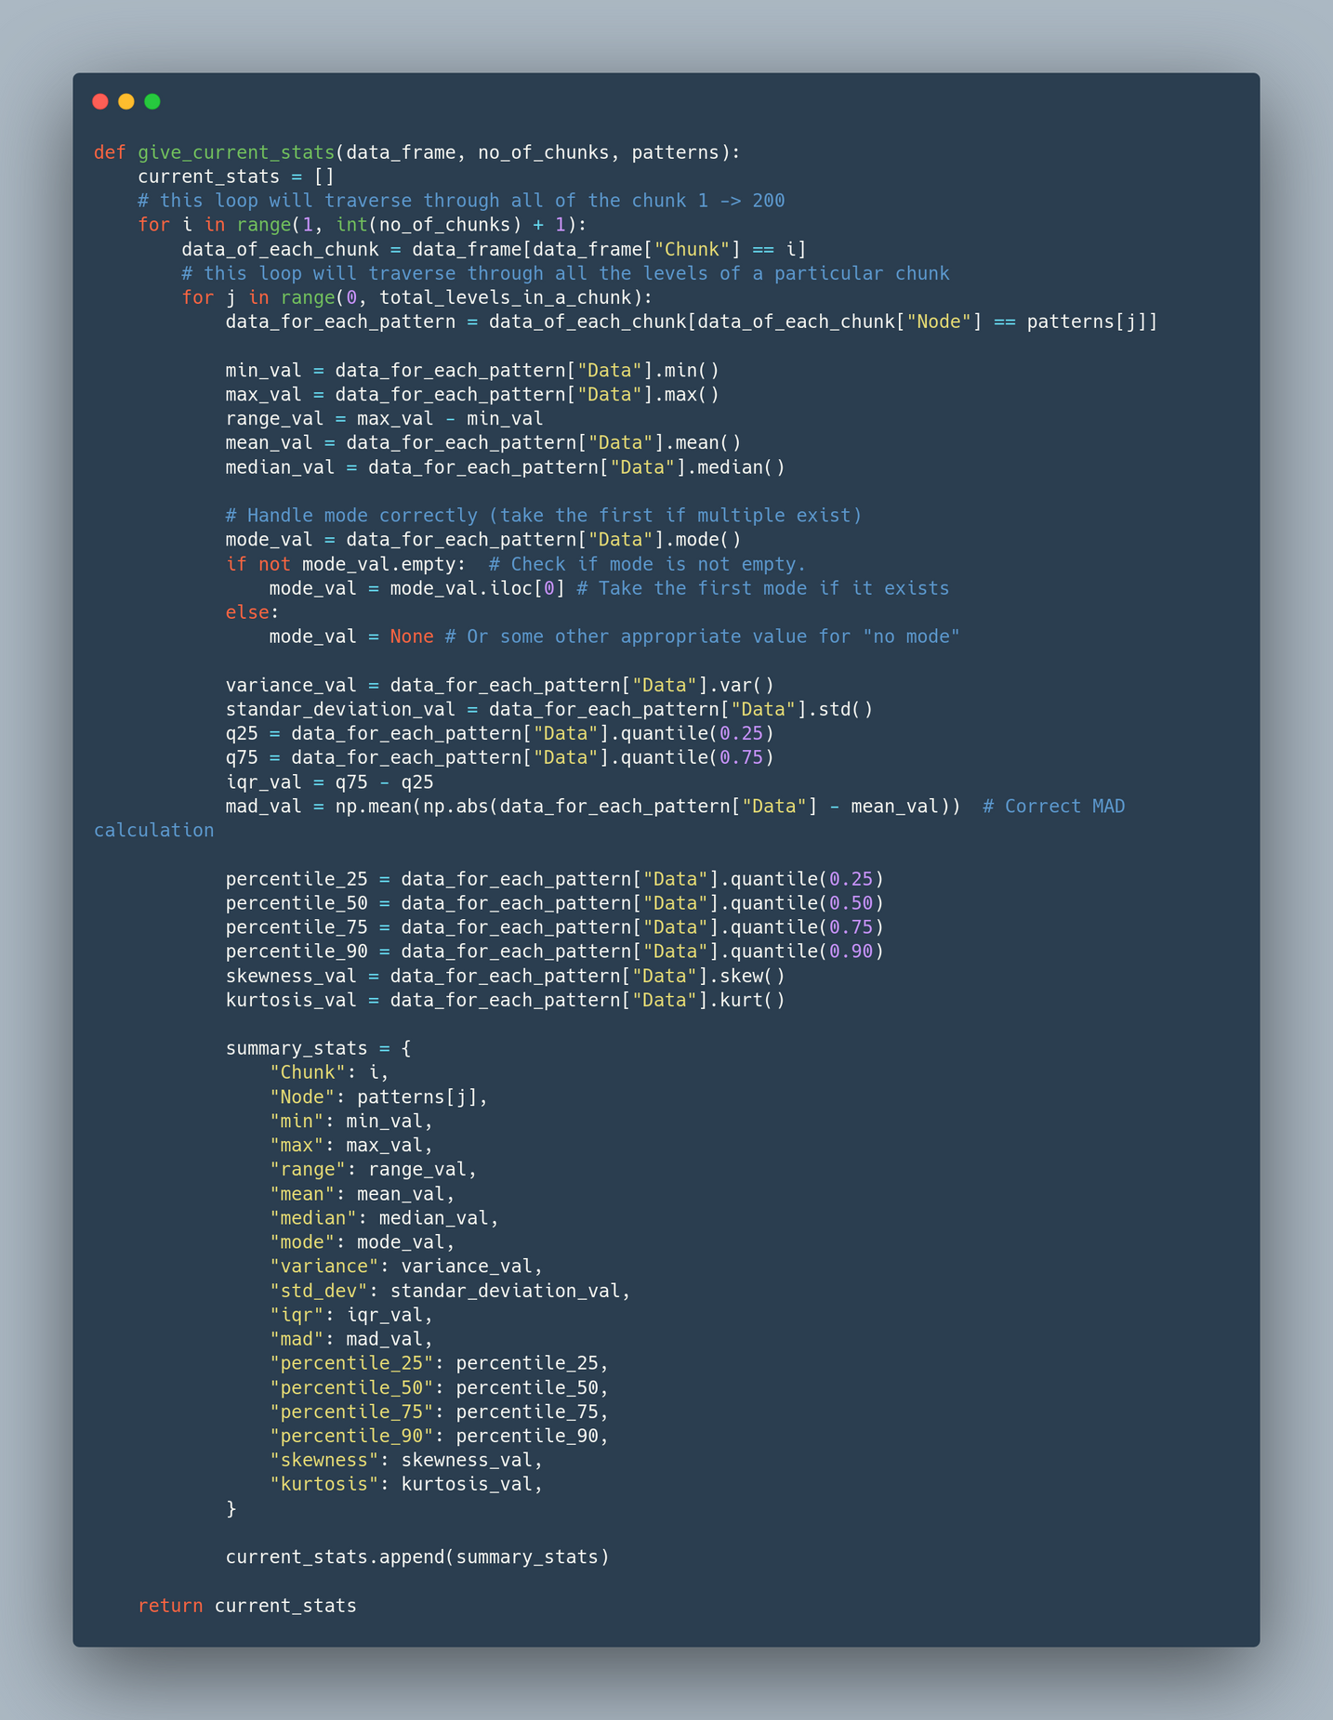
CALCULATING STATISTICAL PARAMETERS
We will be calculating 16 different statistical parameters from our data

Slide 14
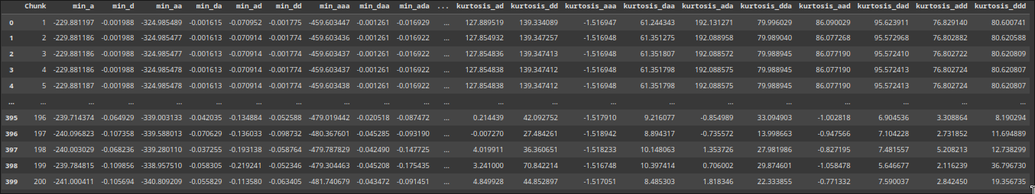
Feature Ranking
Feature ranking assigns a score or rank to each feature based on its importance or relevance to the target variable.
2 classes were created;class 0 and class 1 consisting of data corresponding to normal and fault current respectively.
Out of these 16 features,the feature, for which the difference of corresponding values of both the classes is maximum, is determined using different algorithms.

Slide 15
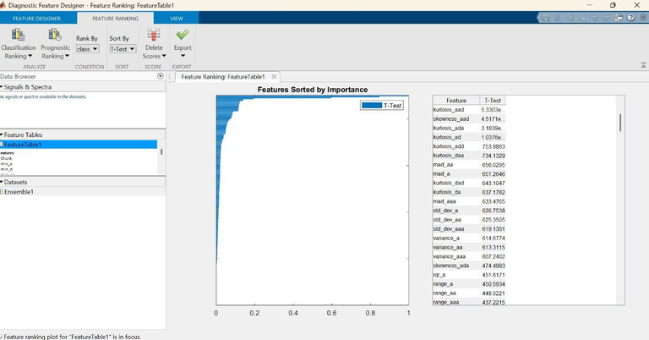
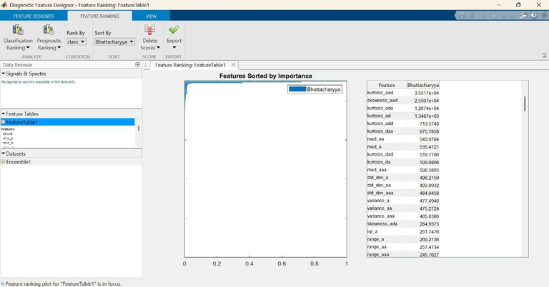
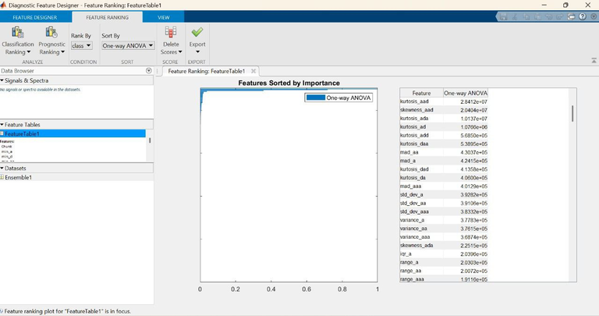
Feature Ranking Methods
T test ranking : T-Test evaluates whether there is a statistically significant difference in feature distributions between two groups. It is particularly useful for normally distributed data.
Bhattacharyya Distance Ranking : Measures the separability between two probability distributions, making it a useful method for feature selection in classification problems.Features with higher Bhattacharyya values exhibit stronger discriminatory power
One-Way ANOVA Ranking : Statistical technique used to compare the variance of multiple groups to determine whether significant differences exist.It is especially effective for multi-class classification problems.

Slide 16
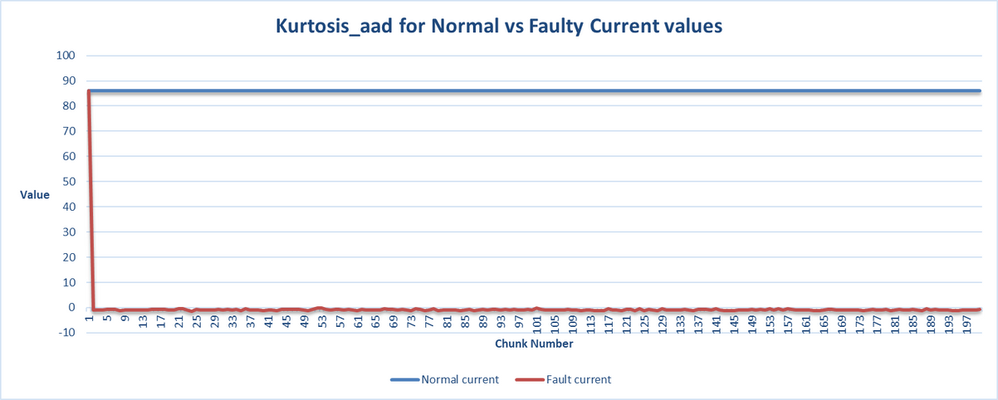
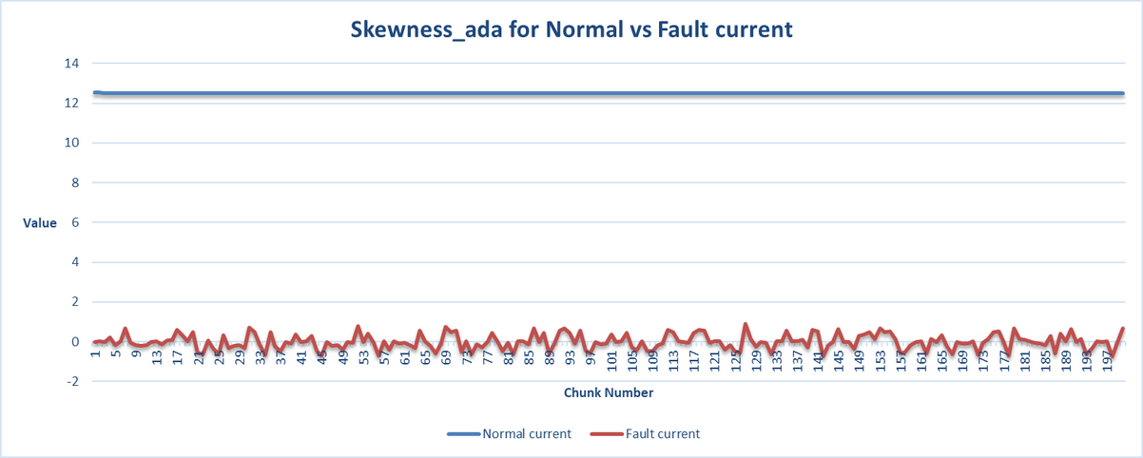
Feature Ranking Result
From the above feature ranking method we can conclude that Kurtosis_aad was identified as the most significant feature across multiple ranking methods, reinforcing its critical role in dataset separability and classification tasks.
Its consistent prominence highlights its ability to capture essential statistical properties, making it a key discriminator in predictive modeling. This finding underscores the importance of leveraging higher-order statistical moments for robust data analysis.

Slide 17
What is a Machine Learning based approach?
A Machine Learning (ML)-based approach refers to the use of algorithms and statistical models that enable systems to learn patterns from data and make predictions or decisions without being explicitly programmed.
It analyzes large sets of current or voltage signals to recognize complex patterns that indicate fault or normal conditions.
Models are trained on historical or simulated data and can generalize to predict outcomes on new, unseen data.
This approach reduces dependency on fixed rule-based systems and enables adaptive, data-driven decision making.

Slide 18
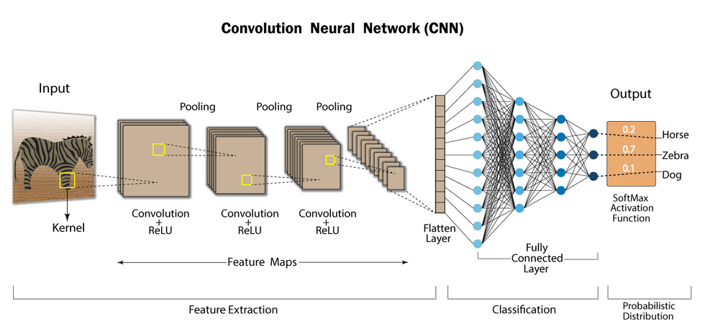
What are Convolutional Neural Networks?
A Convolutional Neural Network (CNN) is a class of deep learning models specifically designed to recognize patterns. It is widely used for image, audio, and signal processing tasks due to its powerful feature extraction capabilities.
Key Components are: Hidden Layers, Convolutional Layers, Pooling layers, Filters, Fully Connected layer, and Activation function.
A 1-D CNN is a specialized form of CNN tailored for sequential or time-series data,such as voltage or current signals.
In our case: Input is sequence of numerical values (i.e., kurtosis of 'aad' node) and it detects patterns in electrical signals to classify faulty vs normal conditions.

Slide 19
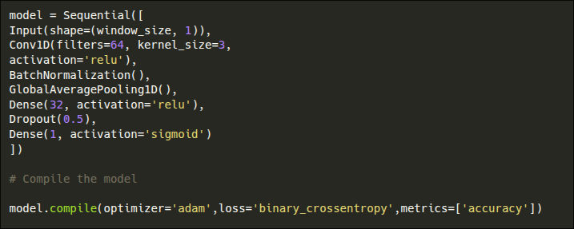
Training our 1-D CNN model
From the flattened dataset, we have found the Kurtosis_aad as the most important feature. The model will be trained in this feature with provided labels. The code block will look like:
The trained model will memorise the patterns and the hyper-parameters and will make predictions for the unseen data based on this memorized info.

Slide 20
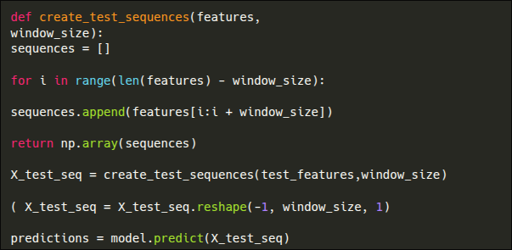
Obtaining the predictions for unseen data
The unseen data will be current values flowing into the model for various instances of time. These values will be processed for the Kurtosis feature and model will make predictions on it.
The code block used is:
The model will return us binary values(0 or 1) as result, clarifying if it’s a normal or fault.

Slide 21
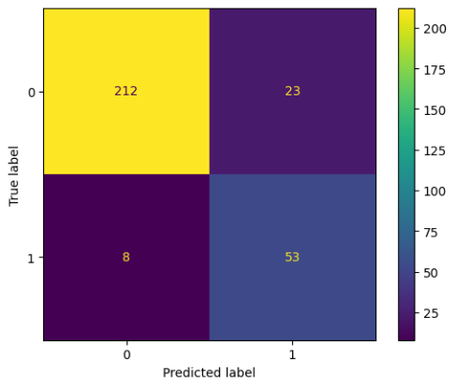
Result
We generated a test set for a duration of 10 sec in which faults are occurring at random instances.
For the prediction our model gave on this test set, we calculated the evaluation metrics :
Accuracy : 89.5%
Precision : 69.73%
Recall : 86.88%
f-1 Score : 77.37%
Confusion Matrix for the predicted values corresponding to the actual ones is

